Slide 1
Maximum Score Demo

Slide 2
Set up
In the first block, we will have 2 multiple answer questions. Each with 10 options.
We will give one point for each option selected
So, theoretically, a person can have a maximum score of 20
But we want to limit our score to 10
So, we will ensure that the maximum one can score in a question is 5 points
In the second block, we will see the following:
The final calculated score
The actual number of items selected

Slide 3
Tools
We will be using three things from Qualtrics
Scoring
Embedded Data Fields or Variables (Different names, same thing)
Branch Logic

Slide 4
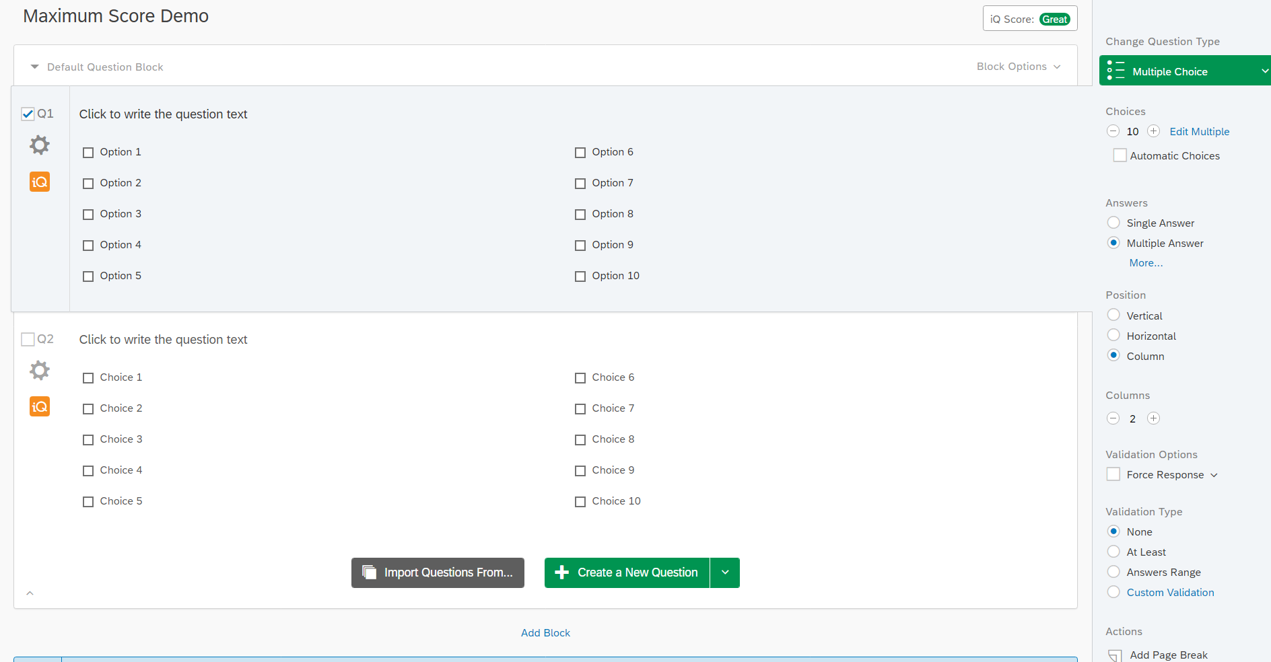
Question Block
You can see that we have set up our question with no restrictions.
People can choose as many answers as they want.

Slide 5
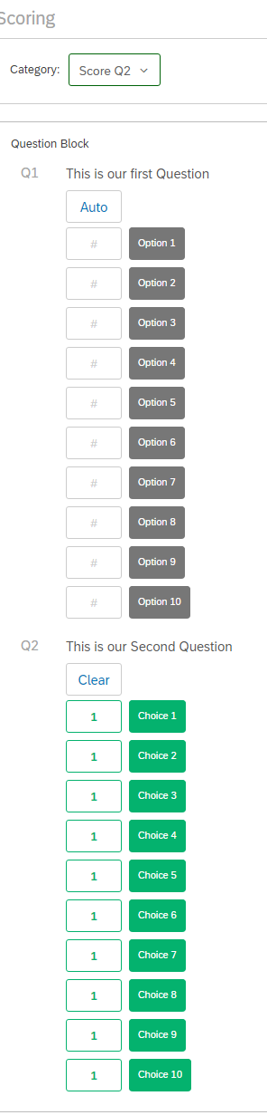
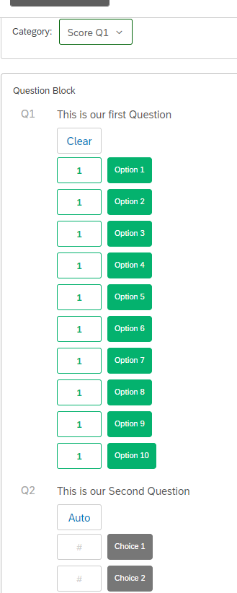
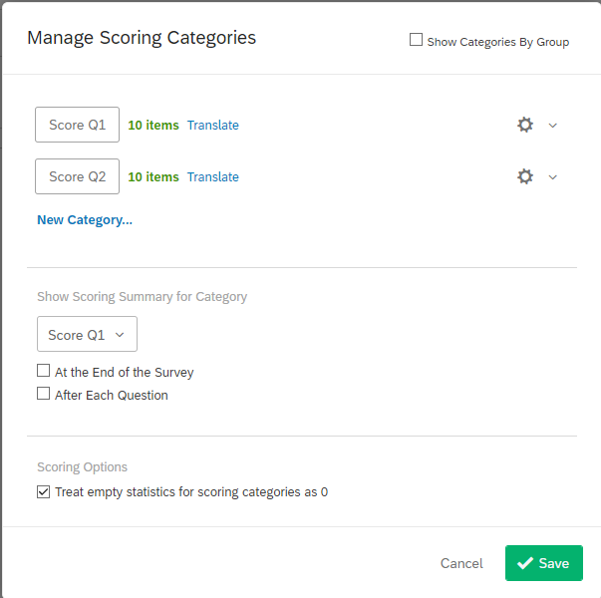
We have set up 2 scoring categories. One for each question.
You can see that in each Scoring category (Score Q1 and Score Q2) we selected only one question.
The other is dark.
This is important.

Slide 6
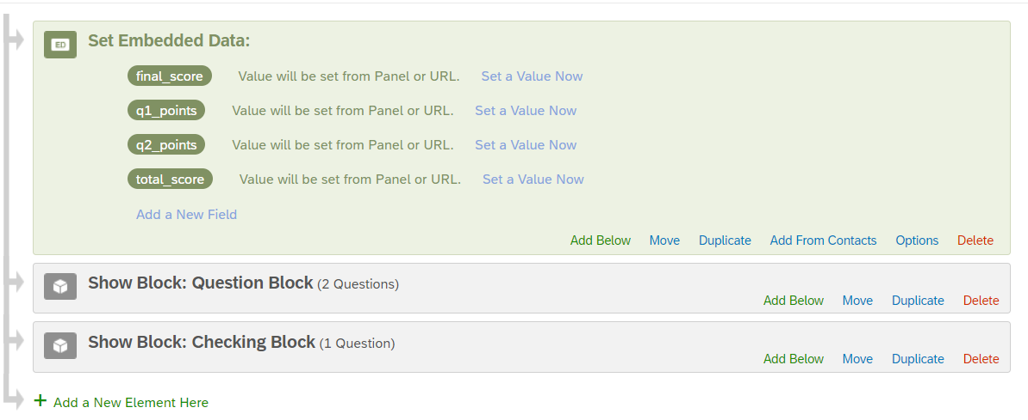
We have created 4 embedded variables to keep track of things.
q1_points will store the points received in question 1 (max 5)
q2_points will store the points received in question 2 (max 5)
final_score will be our desired score (out of 10)
total_score will be the actual unedited score (out of 20)

Slide 7
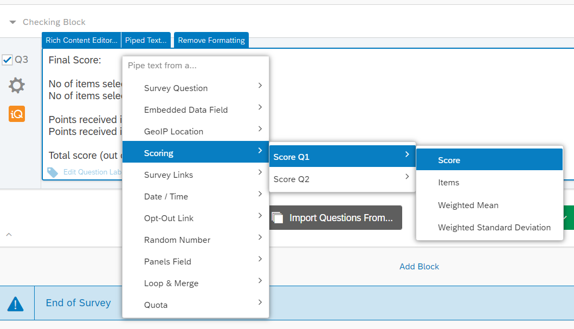
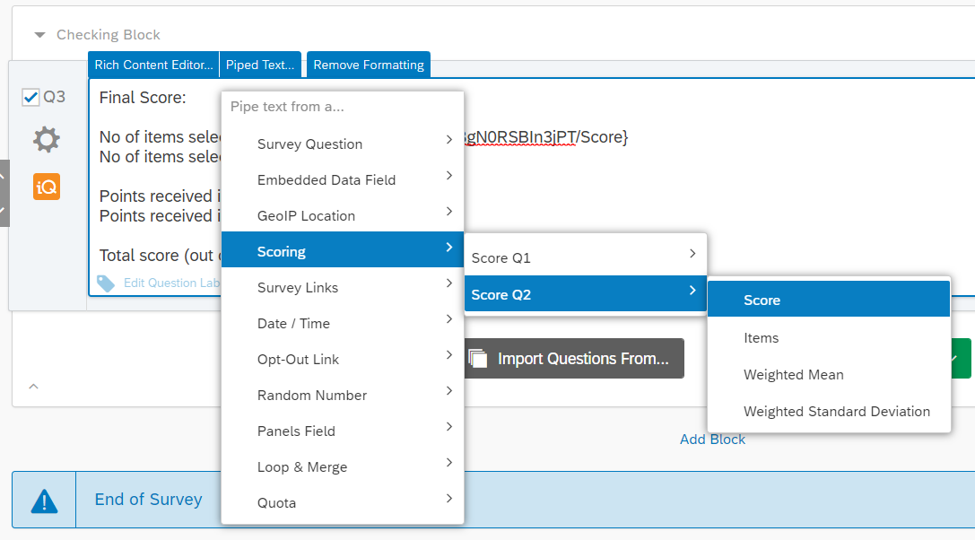
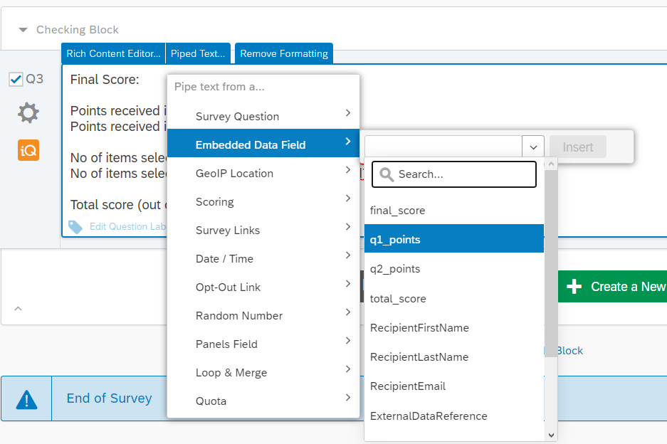
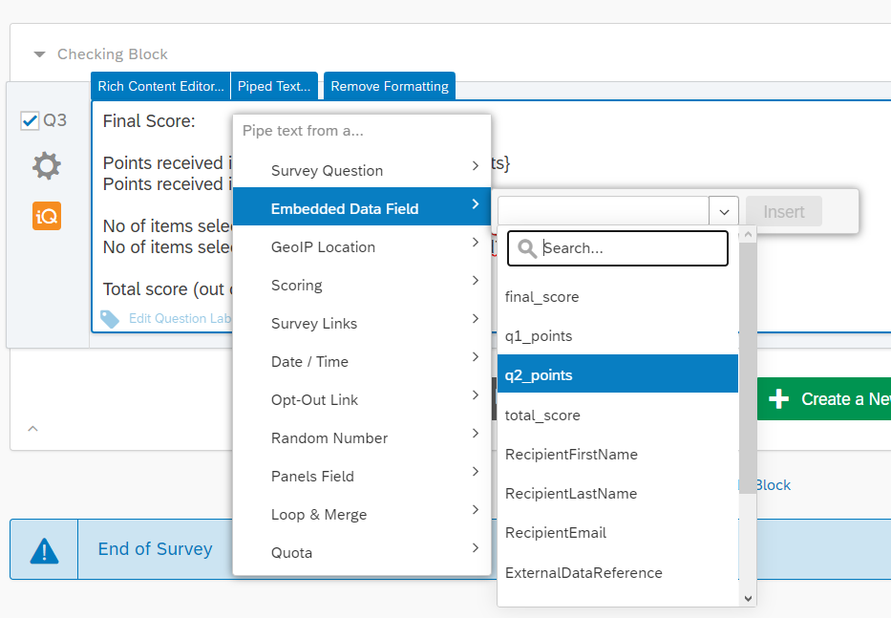
Getting score for question 1 (max 10):
${gr://SC_3aBgN0RSBIn3jPT/Score}
Getting score for question 2 (max 10):
${gr://SC_0Pd7eYa9w6EoKjz/Score}
Getting points for question 1 (max 5):
${e://Field/q1_points}
Getting points for question 2 (max 5):
${e://Field/q2_points}

Slide 8
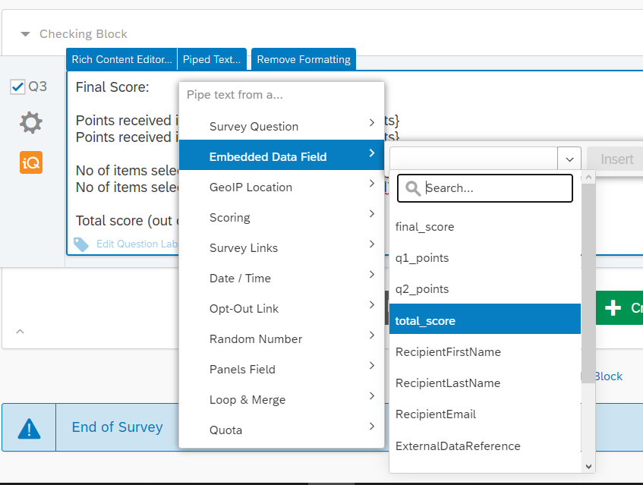
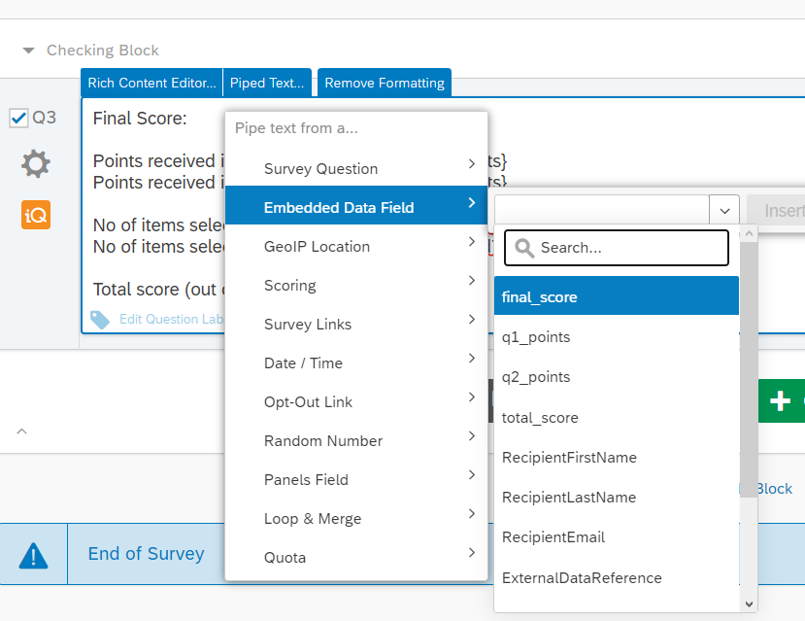
Getting Total Score (max 20):
${e://Field/total_score}
Getting Final Score (max 10):
${e://Field/final_score}

Slide 9
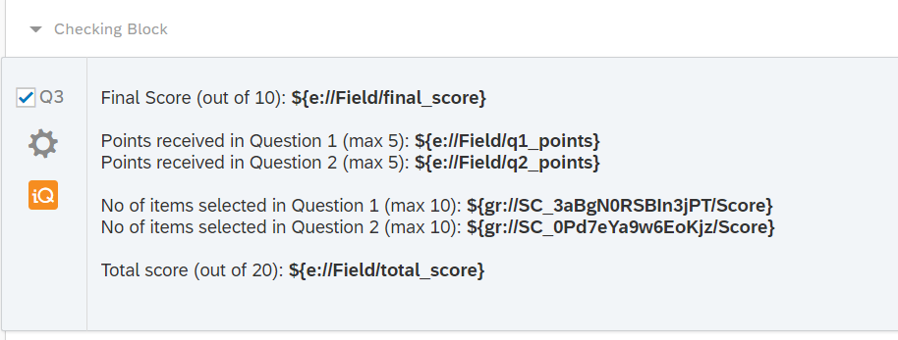
This is how our summary block will look where we can see all out totals.

Slide 10
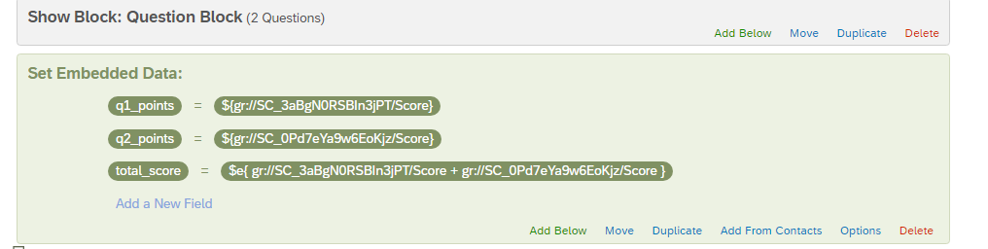
In the survey flow, after the question block, we will once again set the embedded data variables.
This time we will give them values.
You can see that these values are as follows:
q1_points is the score for question 1
q2_points is the score for question 2
total_score is the sum of both of them
We have NOT set final_score here, as it needs the value of q1_points and q2_points, and all of it can not be set together.
You can read about math operations here: Qualtrics Math Operations

Slide 11
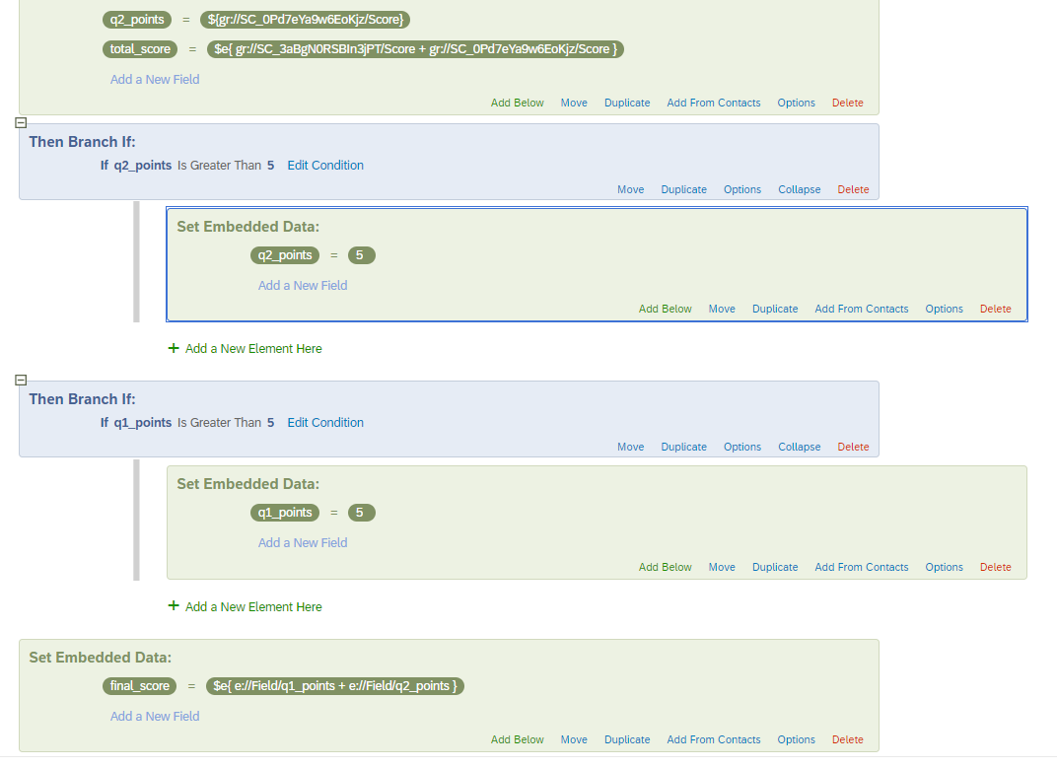
Here we use branch logic to set the number of points to a maximum of 5.
You can see that the condition for branch to get activated is
“If q2_points is Greater than 5”. Then we will set q2_points to 5.
And same for q1_points.
So if their value is less than or equal to 5. It will remain the same, other will become 5.
Lastly, we have set final score to be the sum q1_points and q2_points, using math operations (previous slide has the link)

Slide 12
Our setup is now complete,
and we can proceed to testing

Slide 13
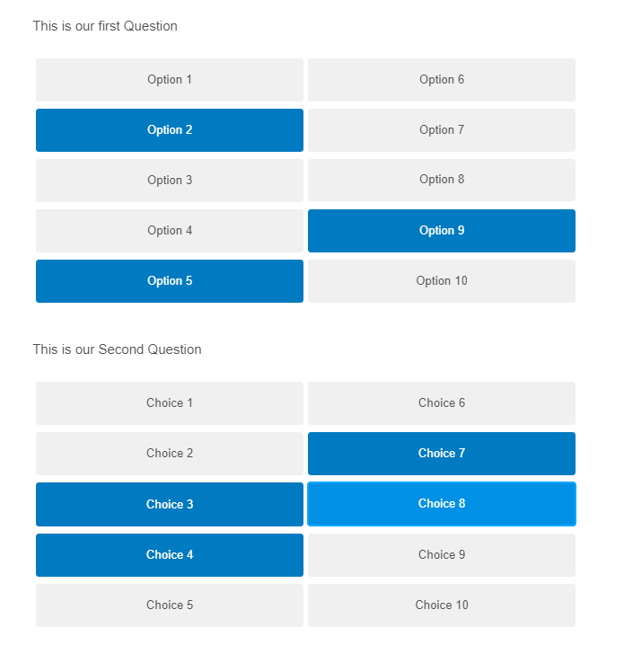
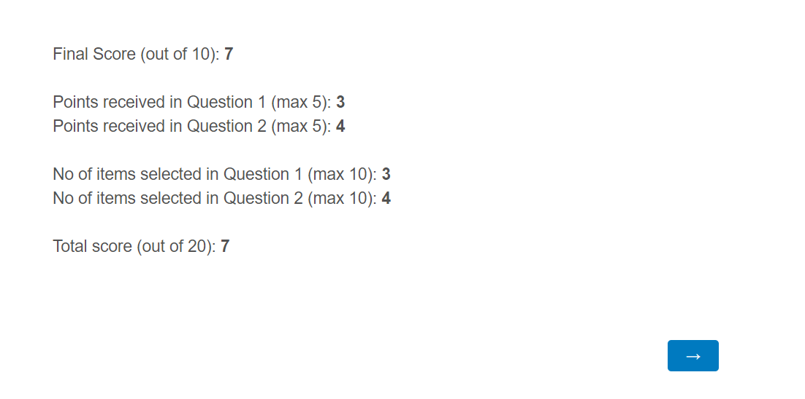
Test 1:
Q1: Select 3
Q2: Select 4
Result

Slide 14
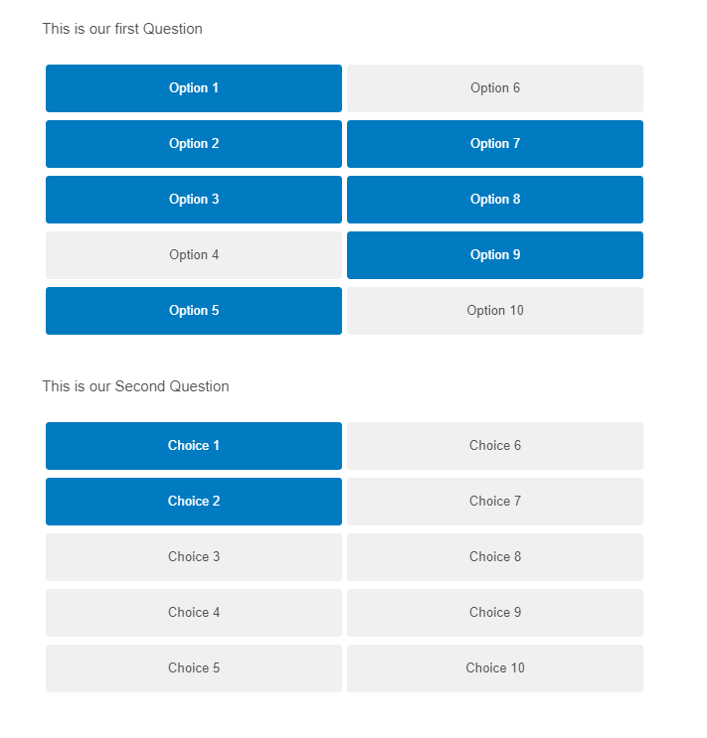

Test 2:
Q1: Select 7
Q2: Select 2
Result

Slide 15
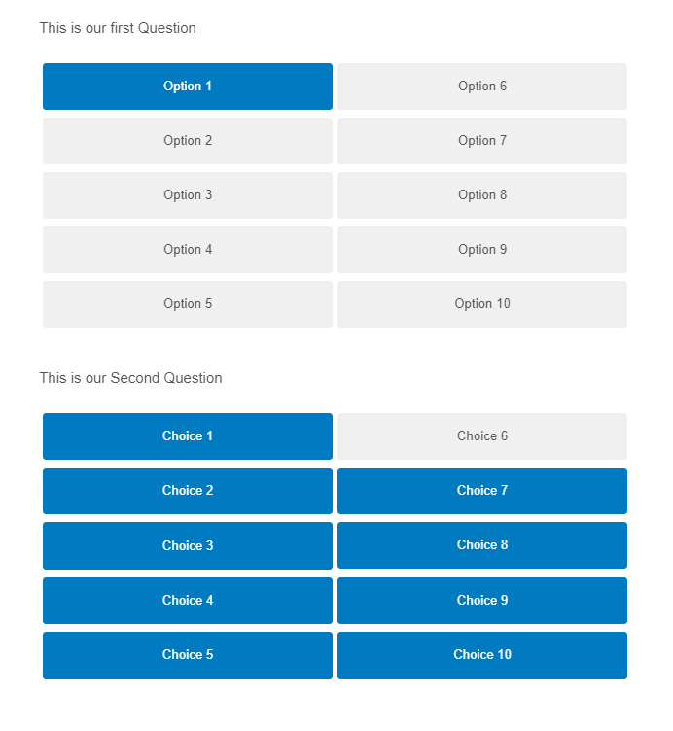

Test 3:
Q1: Select 1
Q2: Select 9
Result

Slide 16
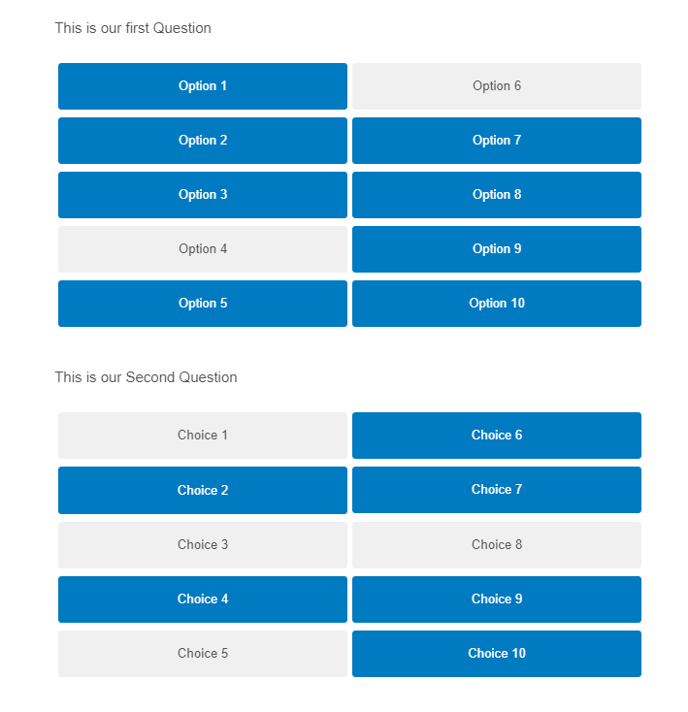

Test 4:
Q1: Select 8
Q2: Select 6
Result

